Slide 1


SAP UI5 & FIORI with OData TRAINING using BAS
Anubhav Oberoy
Day – 4

Slide 2

Agenda – Day 4
Introduction to UI5 SDK.
Views In SAP UI5
XML View
Creating our first view
How UI5 framework works
What is Controller?
Structure of controller
Creating our first controller
Basics of controller
Hook Methods of the Controller
Basics of OOPS
Concept of Control Hierarchy
Basics of Control Hierarchy
Models in SAP UI5
Model Basics
Steps to Create a Model
Data Binding

Slide 3
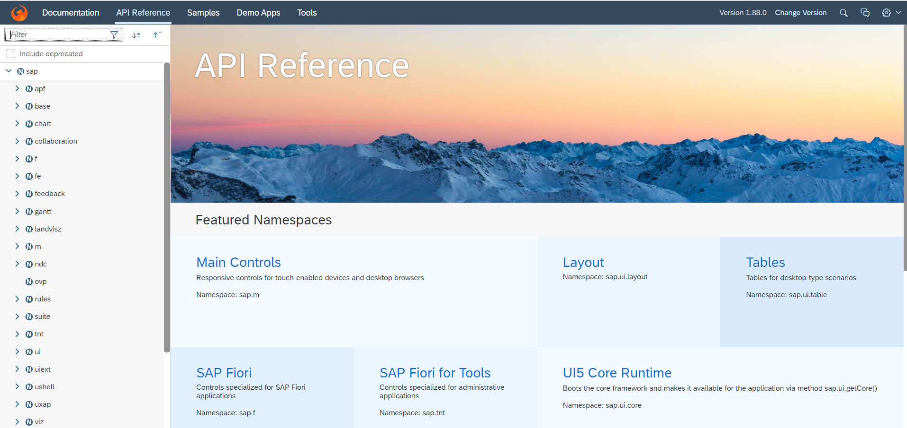
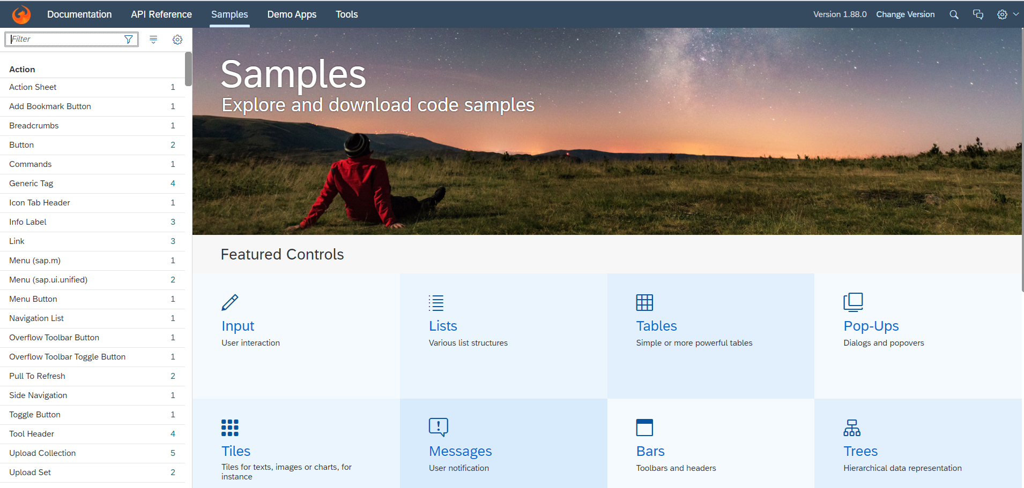
Introduction to UI5 SDK
Documentation of SAP UI5 is available at the SAPUI5 Software Development Kit.
We can access the SAP UI5 API’s at the Documentation page of SAP UI5 or you can use the link to go to sap’s API screen - https://sapui5.hana.ondemand.com/#/api
We can directly search the required api’s on the SDK.
SDK contains the sample of all the controls which we can use in UI5
SAP UI5 API reference screen
SAP UI5 Sample reference screen

Slide 4
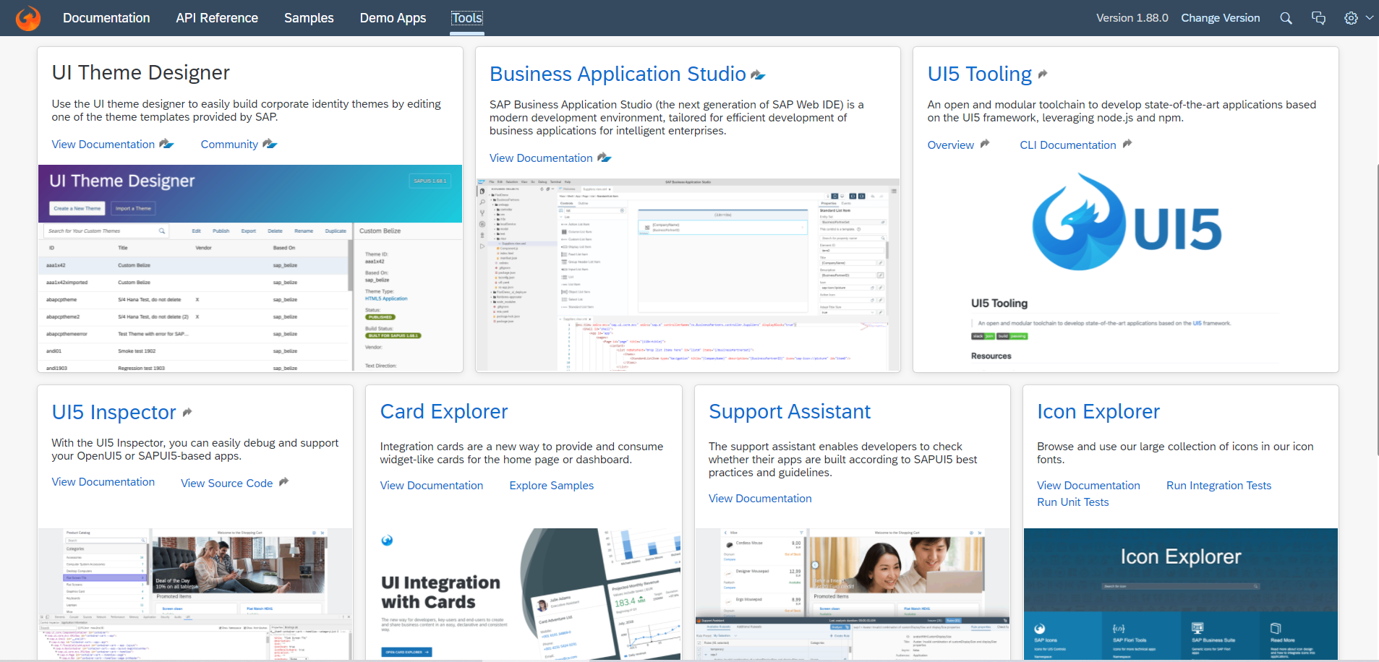
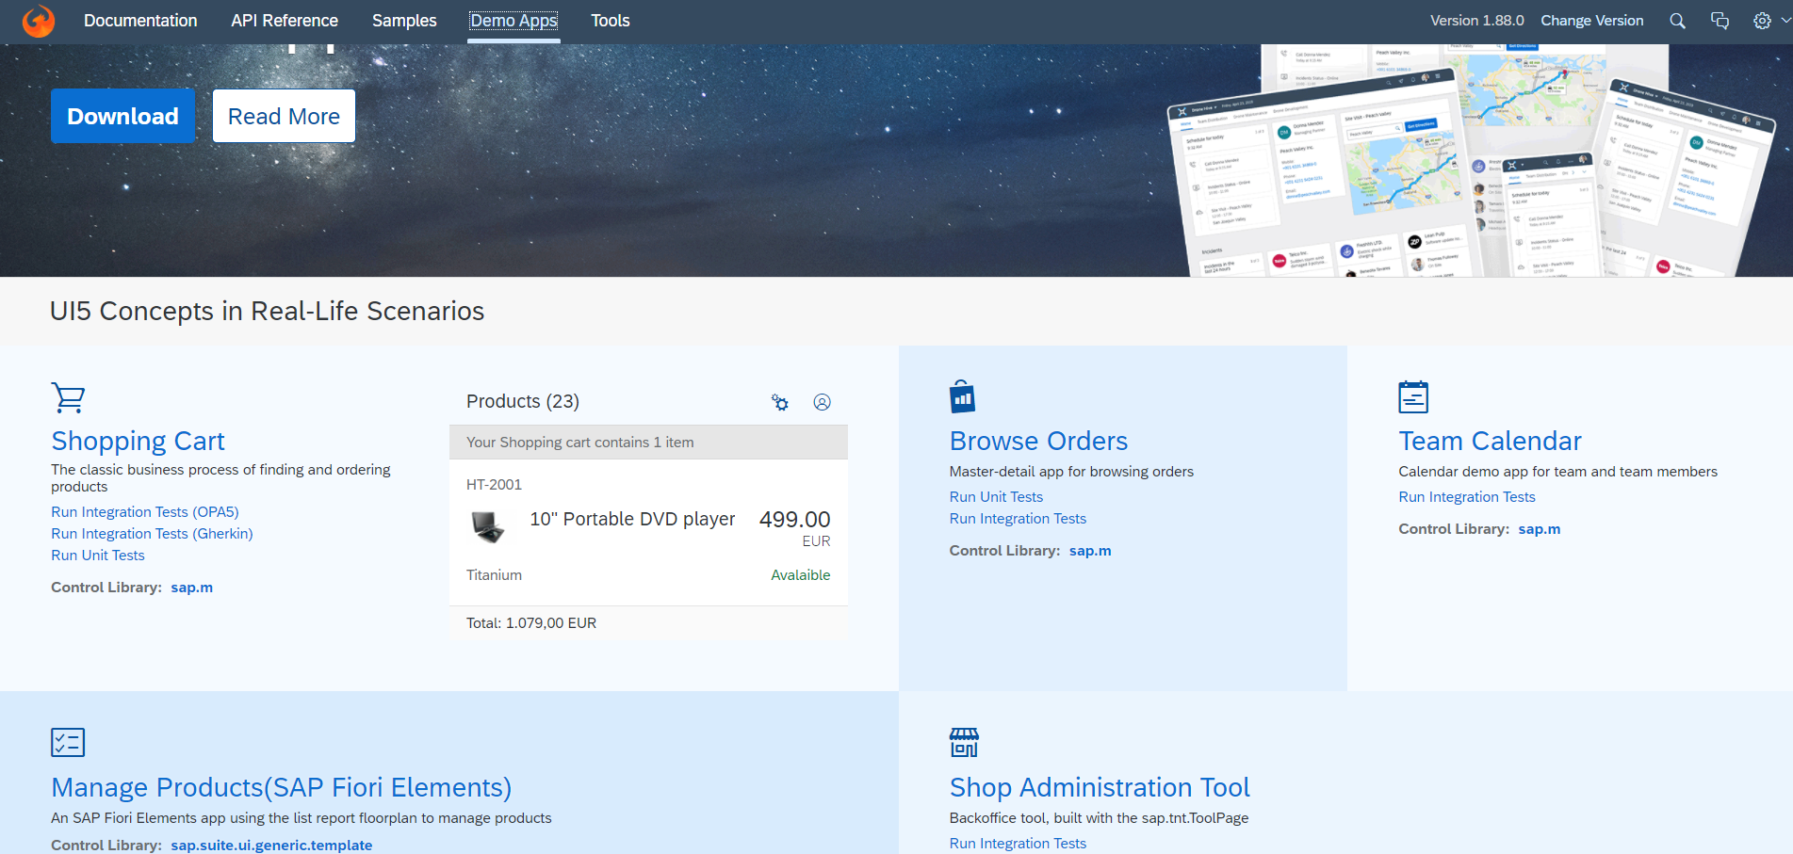
UI5 SDK continues…
UI5 SDK contains tools to make the development smooth for the developers.
It has UI5 icon packs which can be directly accessed for the UI5 SDK’s Tool Screen (Link).
SAP UI5 SDK provides us the demo application, So we can get an idea about how to create different type of applications using UI5 controls
UI5 SDK Tools Screen
UI5 SDK Demo Apps Screen

Slide 5
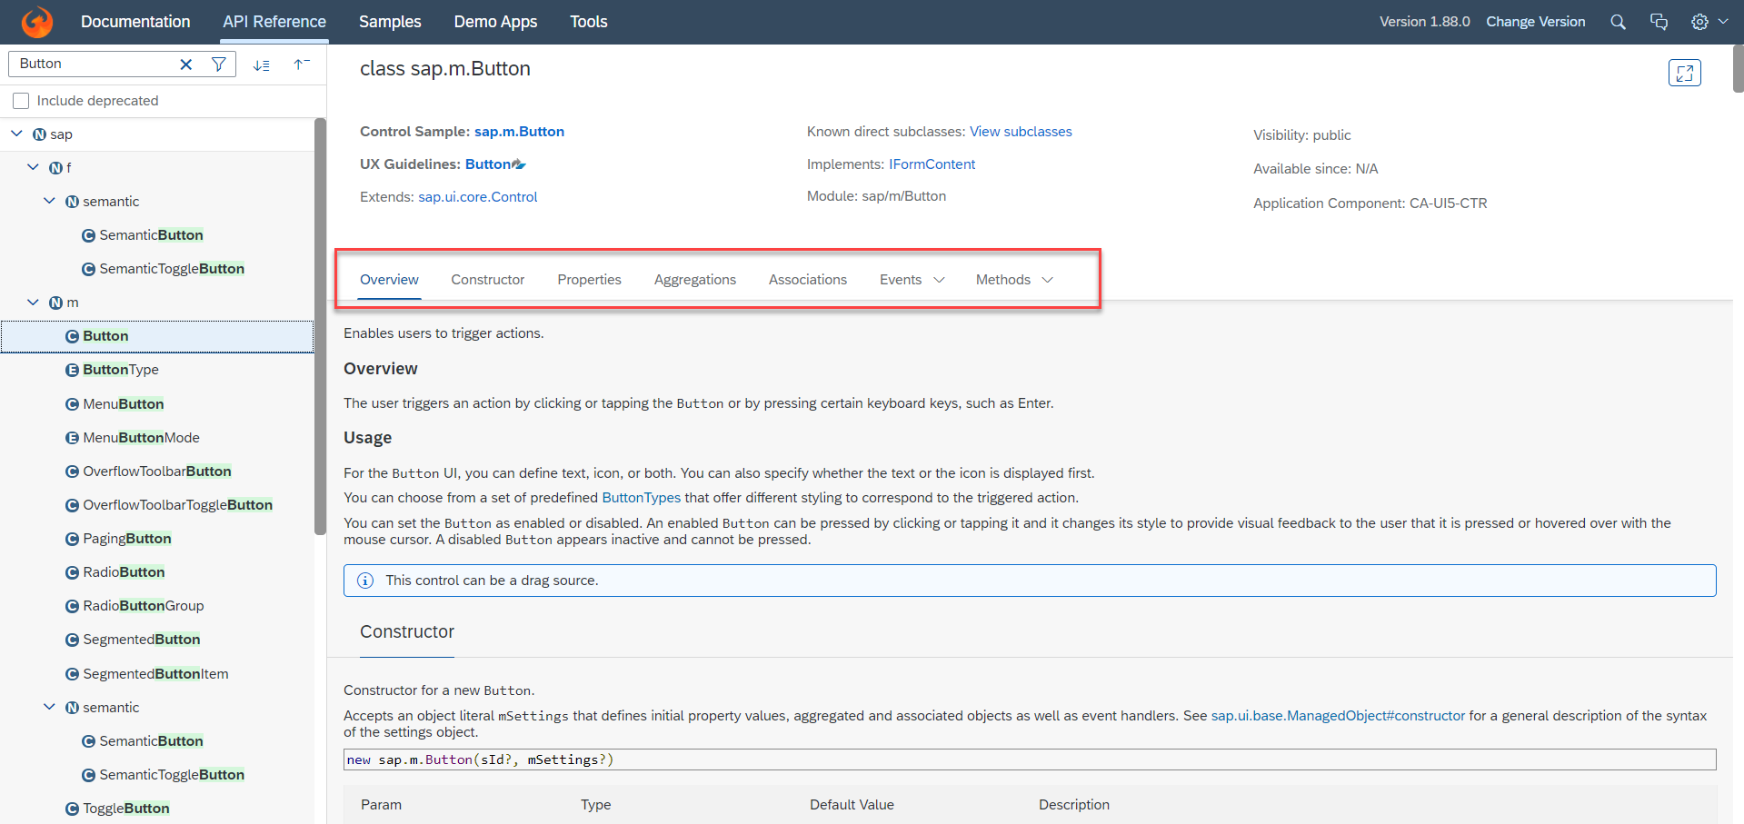
UI5 SDK continues…
When we search and open any API we see a screen similar to one which is shown below.
Every API contains different kind of:
Properties,
Aggregations,
Associations,
Events,
Methods

Slide 6
Views in SAP UI5
View is responsible to manage information display to the users.
Views are based on Model.
There are Four types of views in SAP UI5, these are listed below:
XML View:- It is in the XML format. The file name ends with the extension “.view.xml”. There are no predefined methods in the XML view.
JS View:- It is in JavaScript format. The extension of the view file is “.view.js”.
JSON View:- It is in JSON format. The file name ends with the extension “.view.json”.
HTML View:- It is in HTML format. The file name ends with the extension “.view.html”. Here we create the controls within the <div> tags, as we do while developing HTML pages.
Percentage Usage of Views:
2%
99%
JSON View – 0%
HTML view – 0%
JS View is used only in 2% of the views.
XML Views are the mostly used views now a days.
The use of JSON and HTML views are negligible

Slide 7
XML View
What is XML?
XML stands for eXtensible Markup Language, it was originally developed to move data from one to another technology. It became popular to communicate between heterogeneous technologies.
XML is a tree data structure. Unlike HTML, we can use custom tags. Every programming language must support XML.
Portal
Java
App
ABAP
If_ixml
xml
xml
Data Objects → XML – Rendering
XML → Data Object – Parsing
Why XML View is better than other Views?
It is industry Standard.
XML handles the control id properly
XML rendering is faster
XML properly follows the MVC
Architecture.

Slide 8
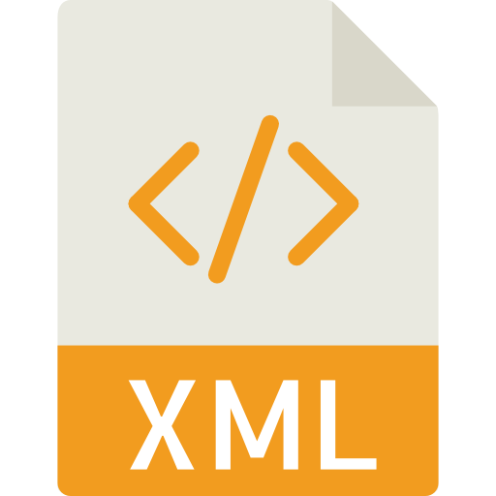
Structure of XML
<data>
<empStr>
<empId>5000</empId>
<empName>Jack</empName>
<salary>9500</salary>
<currency>EUR</currency>
</empStr>
<empTab>
<row>
….
</row>
</empTab>
</data>
Root Element
Child Element of <data> tag
Child Element of <empStr> tag
Skeleton of XML View
<mvc:View xmlns:mvc=“sap.ui.core.mvc” xmlns=“sap.m” controllerName=“pathOfContro.”>
<Button text=“Click Me”></Button>
</mvc:View>

Slide 9
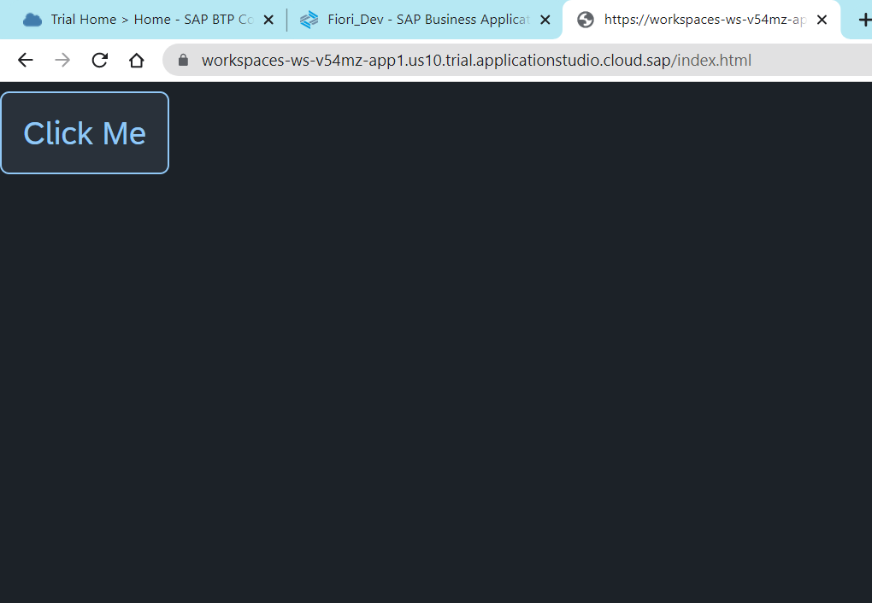
Hands – on: Create First View
Now we have to create folders in the webapp directory named as view.
After that create a view in the view folder named Main.view.xml.
Then add the View code to this file and save. It will show a button on the screen.
Code Link:-
Main.view.xml
index.html

Slide 10
How UI5 Framework works
Browser
CDN
SAP UI5 Framework
View
(Main.view.xml)
controllerName=“…”
Call the controller Name
1
Index.html
3
The framework starts to find the controller with the same name
It will return controller name to the framework
var oView = new sap.ui.view({
viewName: “mickey.view.Main",
type: “XML“
});
2
Loads the view
The object of the controller get all the controls .
6
8
Renderer
7
The view returns all the controls to the renderer
Controller
(Main.controller.js)
onInit() function
The renderer converts it into browser friendly language
Create the controller object
HTML + CSS
4
Call the constructor of controller
Get the object of the controller
5

Slide 11
What is a Controller?
In SAPUI5 except the view, all the JS files will follow a special syntax to create a class (module). As we all know that in software development, the entire solution is designed by creating multiple classes, these classes work together to run our solution. We have dependencies between our class. The syntax which we use is responsible for loading our dependent classes.
A controller is also a class, but since its special (controller) class, we also need to inherit a special SAPUI5 class to mark it as controller. The name of special class is sap/ui/core/mvc/Controller.
In JS we use extend keyword to perform inheritance.
A module name is derived from a class name in SDK by replacing every dot (.) with slash (/)
This syntax will load all the dependent classes asynchronously, this is why the syntax is called AMD like syntax (Asynchronous module loading). Also called scaffolding template.
Skeleton of any JS file in SAP UI5 – Considered as a class
sap.ui.define([“dependencies”, “dep2”, “dep3”],
function(oD1, oD2, oD3) {
--logic—
}
);
The Syntax of the controller has the AMD(Asynchronous Module Loading) like structure . This is also Know as Scaffolding Template
Modules

Slide 12
Structure of Controller
We define a simple controller as follows:
sap.ui.define([ "sap/ui/core/mvc/Controller" ],
function(Controller) {
"use strict";
return Controller.extend(“Address of Controller", {
// controller logic goes here
});
});

Slide 13
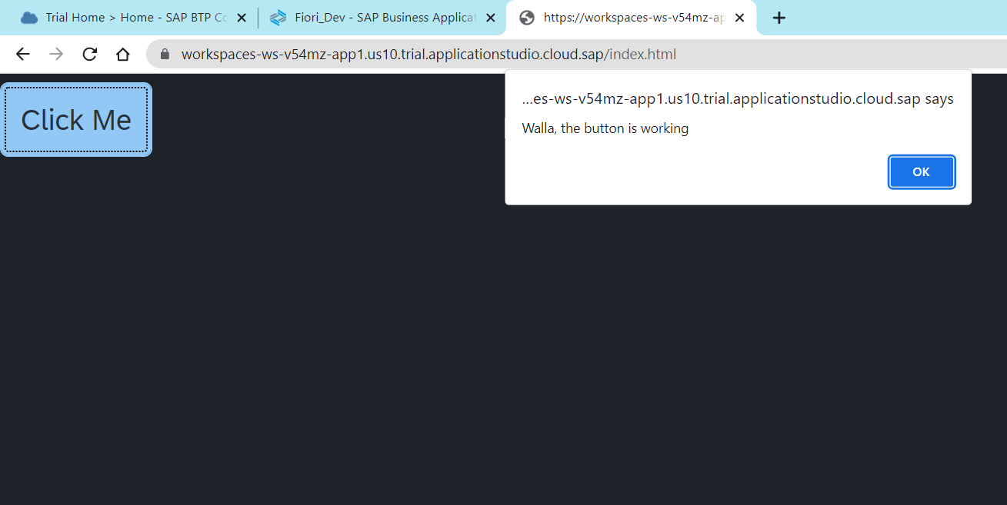
Hands – on: Create First Controller
Now to make our button work we have to add some control logic to it, that logic will be written in the controller.
To add a controller to the project make a controller folder in the webapp directory and in that add a file named Main.controller.js.
In that file add the basic controller code in it and a function to show a alert message on click of the button.
Code Link:-
Main.view.xml
Main.controller.js

Slide 14
Basics of Controller
A controller contains methods that defines how models and views interact.
Whenever we see a property for a control, we will always have setter and getter methods to manipulate and read the property value. E.g. an Input control has value property, we will have setValue and getValue method for the same.
In order to work with a control inside the controller, we need to obtain object of that control. To obtain the control object we must not use the document.getElementById because it will give the object of HTML control not the object of UI5 control.
To obtain UI5 element object, we need to first get View Object,
We will obtain the view object inside the controller using this.getView()
this is the object of my current class, so inside controller it will point to current class
We can now obtain the object of the control using this.getView().byId(controlId)
For every event in UI5, we have attachEvent, detachEvent, fireEvent methods as well, which can be used to link, delink and trigger event programmatically.

Slide 15
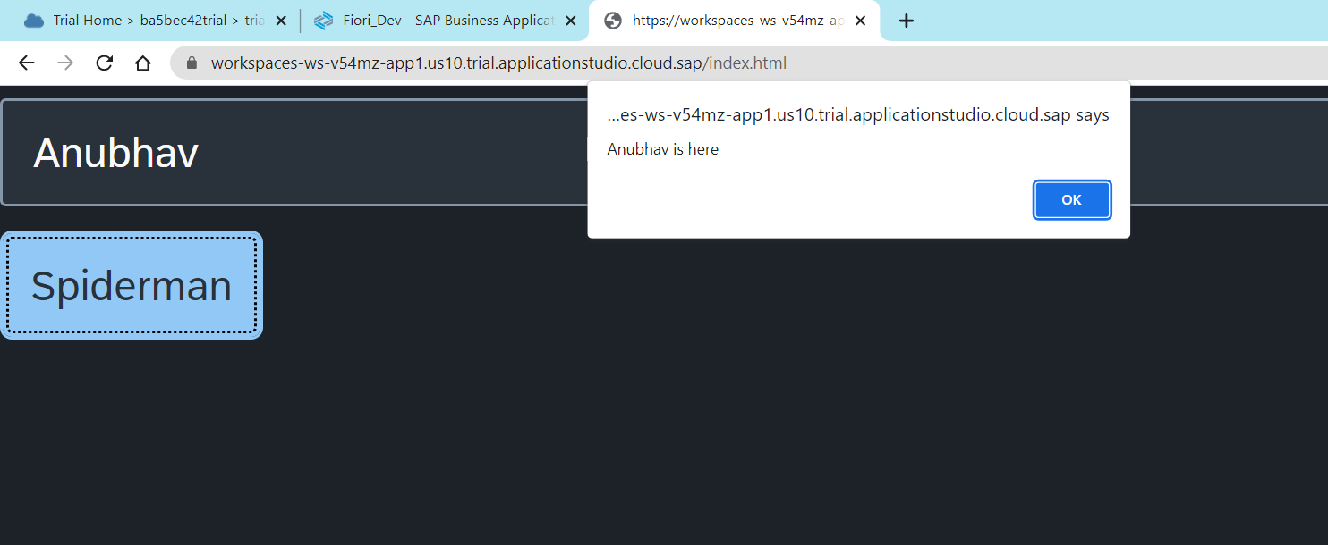
Hands – on: Getting object in Controller
Now add a Input field in the UI. When we enter something in the Input field and press the below button a alert popup will come with the value which is given in the input field
Code Link:-
Main.view.xml
Main.controller.js

Slide 16
Hook Method of Controller
onInit()
onBeforeRendering()
It is a function which gets called immediately after UI5 creates the object of our controller. It is like constructure of a class. We can use this to initialize our class variable
It is a method which gets called MULTIPLE times, Before every time the view is displayed to the user. We can use this method for pre-processing on a view.
IN
BR
EX
AR
onExit()
onAfterRendering()
It is a function which gets called before the instance of our controller gets destroyed. It is like destructor of a class.
We can use this to write clean-up code.
It is a method which gets called MULTIPLE times, After every time the view is displayed to the user. This method can be used to show effects to the user.

Slide 17
Basics of OOPS (Object Oriented Programing)
PASSENGER
+passport no +name +nationality
Walk(), talk(), print_boarding()
0..n
PLANE
+Airline +Width +Height
+fly(), +land(), #load()
ENGINE, WINGS
+capacity, +speed, +color
inheritance
PASSENGER PLANE
+no_of_seats
Load()
CARGO PLANE
+cargo_space
Load()
Association (relation between classes which are not of same group of family)
1. Aggregation – lose coupling, both objects can function independently, SHOULD have relation
2. Composition – tight coupling, both cannot function independently, MUST have relation

Slide 18
Concept of Control Hierarchy
Concept of control Hierarchy tells us about how the SAP UI5 Controls are structure on the basis of the object oriented Paradigm.
Note:- Whenever we see a control, and if we are unable to find a property, association, event or function in that class, check its parent class.
sap.ui.base.ManagedObject
sap.ui.core.Element
sap.ui.core.Control
sap.m.Button
sap.m.InputBase
sap.ui.view
sap.m.Table
sap.ui.layout.form
sap.m.Input
sap.m.Column
SimpleForm
Some Frequently used Controls

Slide 19
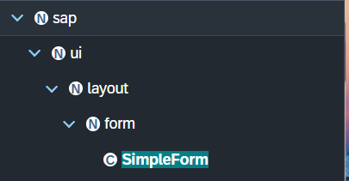
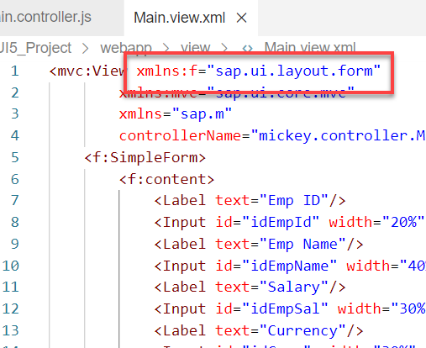
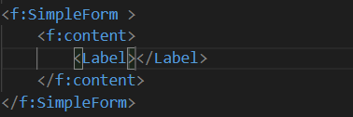
Basics of control hierarchy
To use any control , first we have to include controls’ parent class into the view
For example: To use the SimpleForm we have to include its parent class which is sap.ui.layout.form
The namespace have to given to the parent class
xmlns:f=“sap.ui.layout.form”
When we use the aggregation of any control same namespace will follow by the aggregation as parent.
The control name must start with capital letter and the aggregation name starts with small letter.
We have to check which control will aggregate to the control itself, if the aggregate control is the Control class or element class we can pass any of their child class to the aggregation.
for example:
As the <f:content> extend the element class we can use the <Label> which is also child of element class inside the <f:content>

Slide 20
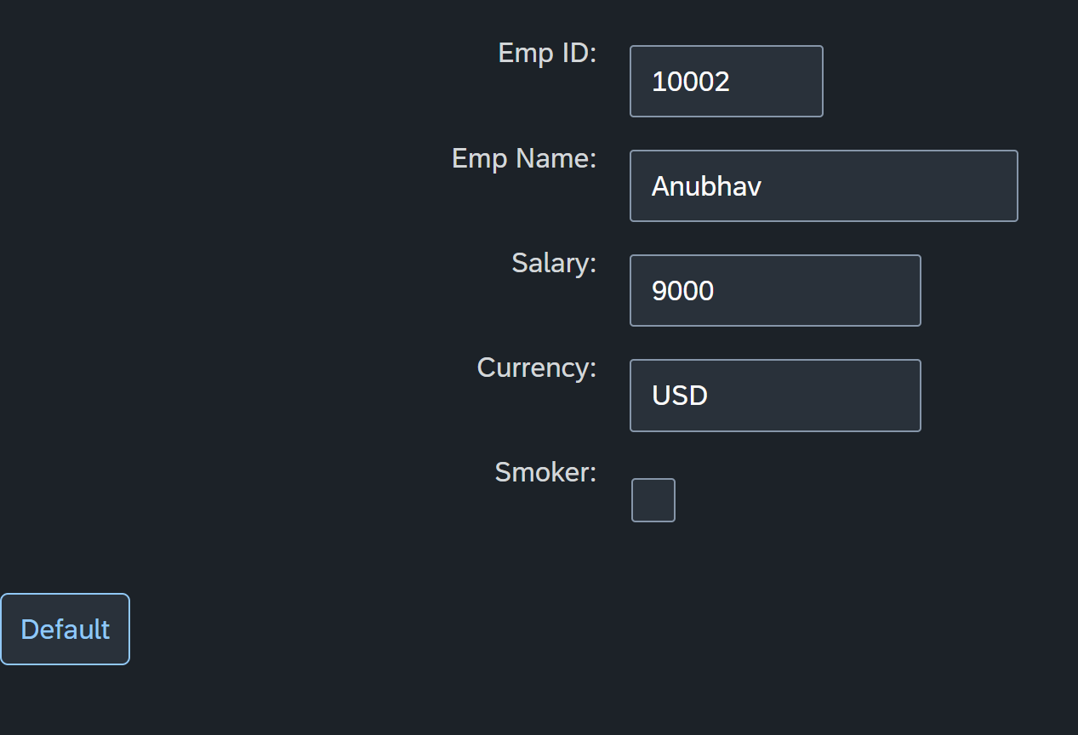
Hands – on: Simple Form Control
Now create a Simple form control in the View.
Along with that we will add a button below the Simple form and on press of that button change the value of one field in the Simple form.
Code Links:-
Main.view.xml
Main.controller.js

Slide 21
Models in SAP UI5
Models are the Object of the data. It contains all the data related to the application .
The various model types supported by SAPUI5 are:
OData model
JSON model
XML model
Resource model
Each model in SAPUI5 is mainly used to bind controls to the data brought in. The JSON model is a client-side model which is recommended for datasets with small amounts of data.
Server Side Model
These three are the Client side model
%
Usage of Models:
100
100
100
95
80
Usage in Percentage
60
40
40
20
Models
OData
JSON
XML
Resource

Slide 22
Model Basics
All the models in SAP UI5 are characterized in two different parts:
Client-Side Model: -
Client Side Model are the models which keeps the data in the browser (client side), when app starts all the data will be loaded in one shot to the browser and kept there.
These models are used when the dataset is small and we want to manipulate data locally.
E.g. why we use internal table? – it’s a temporary store to manipulate the data and once we finalize we push data back.
Server-Side Model: -
Server Side Model are the models which keeps the data in the SAP system(server side), when app starts all the data will be loaded in one demand to the browser in a client side model from, server side model.
These models are used when the dataset is large and we want to fetch and store data back to SAP.
Imagine we have 20trillion records in our sap system, we cant access all data at once in mobile fiori app, so we use server side model to load it chunk by chunk.

Slide 23
Steps to Create a Model
There are 4 Easy Steps to Create a Model:
Step 1: Create a brand-new object of the Model
To Create JSON Model - var oModel = new sap.ui.model.json.JSONModel()
To create XML model – var oModel = new sap.ui.model.xml.XMLModel()
To create Resource model – var oModel = new sap.ui.model.resource.ResourceModel()
To create OData Model – var oModel = new sap.ui.model.odata.v2.ODataModel()
Step 2: Set or Load the data in the Model
oModel.setData({});
oModel.loadData(filePath);
Step 3: Make the model aware to the application/view
sap.ui.getCore().setModel(oModel) -- whole city knows where the gold is
this.getView().setModel(oModel) -- only the single view and its child control knows – only my family
this.getView().byId(“controlId”).setModel(oModel) -- one control have access to data – my dad
Step 4: Data Binding : It is the concept of mapping the Views and Model with which the UI knows where the data is into the model. This is done by calculating the path (address of the data).
Create object of the Model
Set/Load Data in Model
Set Model at View Level

Slide 24
Data Binding
Data binding is the process that establishes a connection between the application UI and business logic.
It is a bridge between a binding target(View) and a binding source(Model).
In the json data we can make address as “Every curly braces is converted to / and every array item is converted to /index”.
{"empStr": {
"empId": 0001,
"empName": "Anubhav",
"salary": 8000,
"currency": "USD"
},
"empTab": [{
"empId": 0009,
"empName": “Ananya",
"salary": 9500,
"currency": "USD“
}, {
"empId": 0010,
"empName": “Shwetha",
"salary": 10000,
"currency": “EUR"
}]}
Q: what is the salary of Anubhav
/empStr/salary
Q. What is the emp name of emp 0001
/empStr/empName
Q. What is the salary of Shwetha
/empTab/1/salary
Q. What is the empId of Ananya
/empTab/0/empId
This is the address of the data
To bind the data with the view we have to give the path of the data , so we have to use the curly braces as :
{/empStr/empName}
This is the path of the data

Slide 25
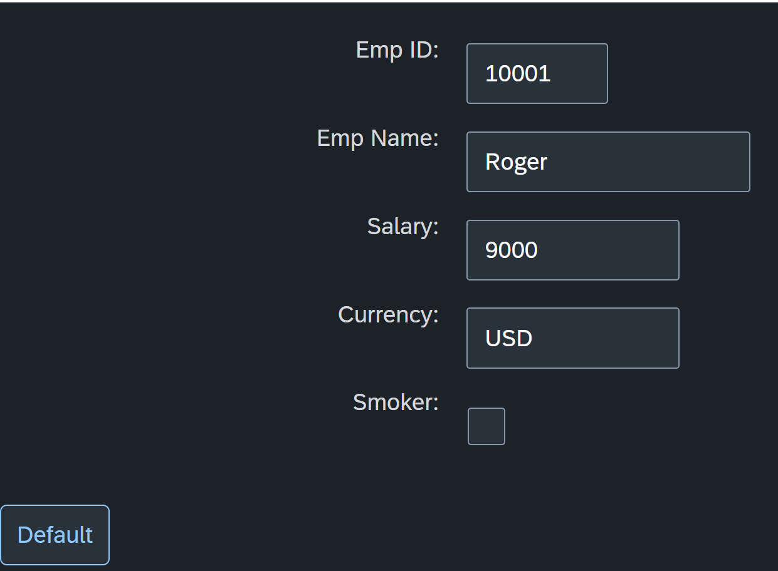
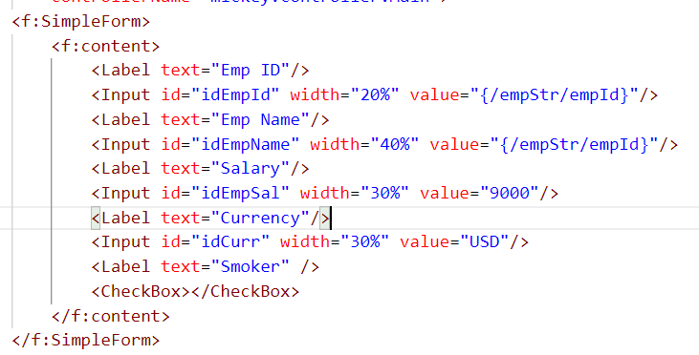
Hands – on: Create our first Model
Create a JSON model by following the steps explained in the previous Slides.
After Creating the Model bind the model to the SimpleForm using different binding Syntaxes.
Code links:-
Main.view.xml
Main.controller.js

Slide 26

End of Day 4

Slide 27

Questions

Slide 28

Anubhav Oberoy

Slide 29


We’re committed to empower you to be
Most Desirable Resource
through powerful training solutions.
We build the workforce of the future.
250+
Corporate Clients
30,000+
Learners Trained
25000+
Learners Placed
FREE WEBINARS
Sign up for free webinars with industry experts every fortnight!
Enroll Now!
Contact us today!
https://anubhavtrainings.com/

Slide 30




More from AnubhavTrainings.com

Slide 31
Title
Content

